Slide 1

A Geographic Breakdown of Unemployment
Yamin Alam, Tohibur Paiker, Enock Descopin, David Cimino, Yuba Sigdel

Slide 2
Motivation
Which groups in the United States are affected the most by Unemployment?

Slide 3
How high are unemployment levels relative to each other across the United States?
A relative comparison of unemployment levels will help us see which areas in the United States are suffering more from high unemployment

Slide 4

Which job types are being hit the hardest by unemployment?
This gives us a different layer to look at who is being affected by unemployment. It can give us insight into which job types are disappearing in the modern economy.

Slide 5
Which Ethnic Groups suffer the most from Unemployment?
This will give us more information about who is affected by unemployment. Though a geographic breakdown gives us some insight, it will only show which areas suffer from unemployment.
With this approach, we can look more at people

Slide 6
Geographic Breakdown of Unemployment
Requires localized unemployment data across the country
This data can be retrieved from the US Census
Visuals will require geographic data for the local areas
This data can be retrieved via API requests from Gmaps

Slide 7
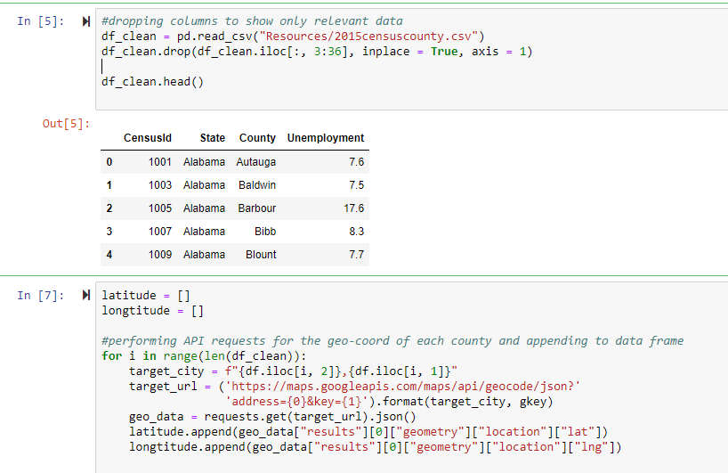
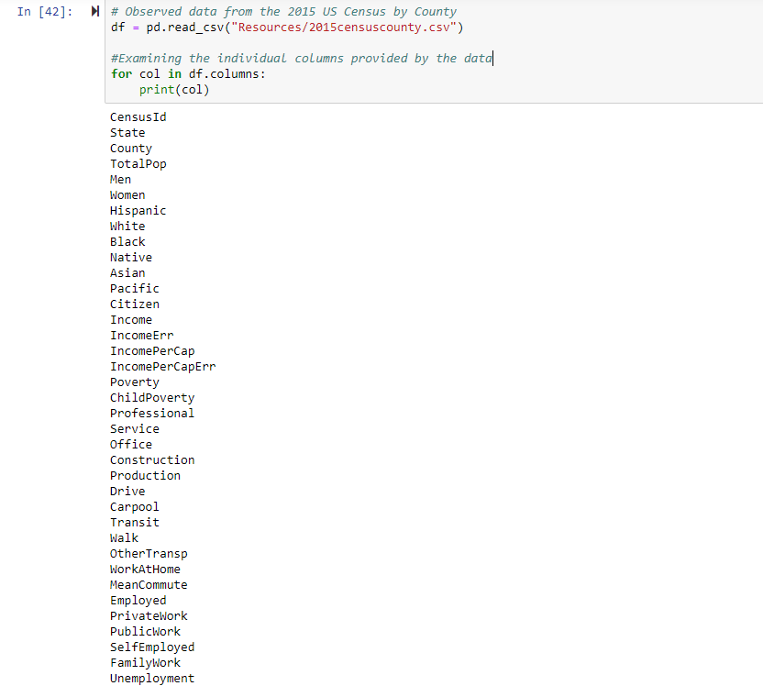
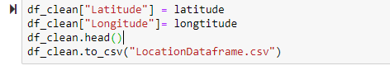
Data Cleanup Process

Slide 8
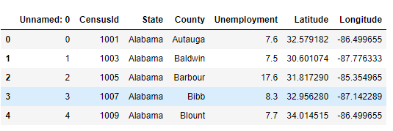
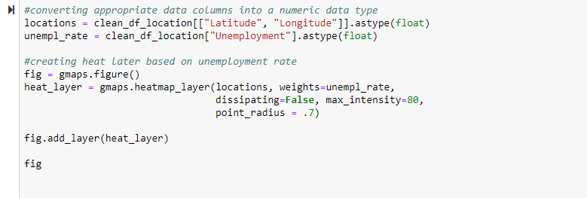
Visualization Buildup

Slide 9
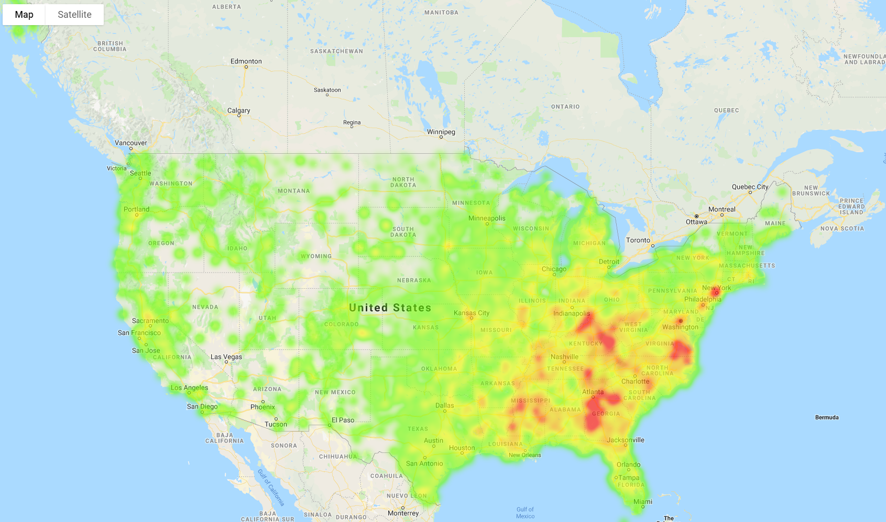

Slide 10
Jobs in Demand
Requires localized job-type breakdowns
This is included in the data; we will make modifications so that we can compare “blue-collar” jobs to “white collar” jobs
We will do this breakdown in a similar manner to heat map analysis for unemployment

Slide 11
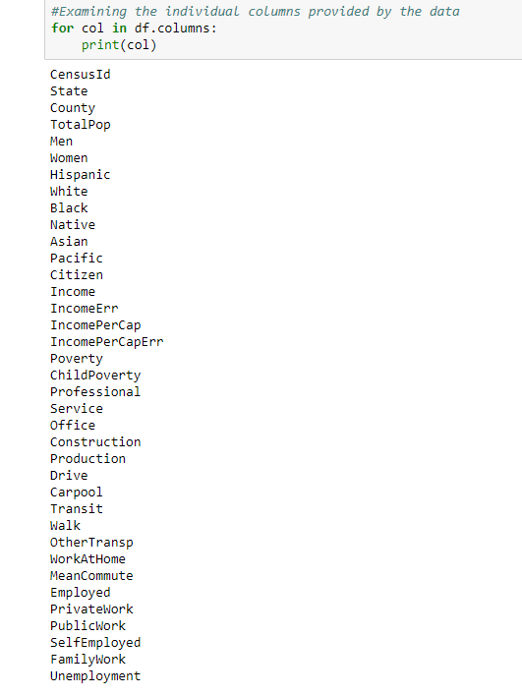
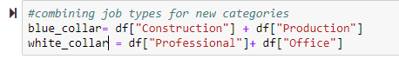
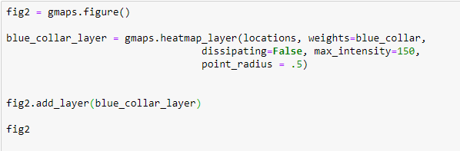
Visualization Buildup

Slide 12
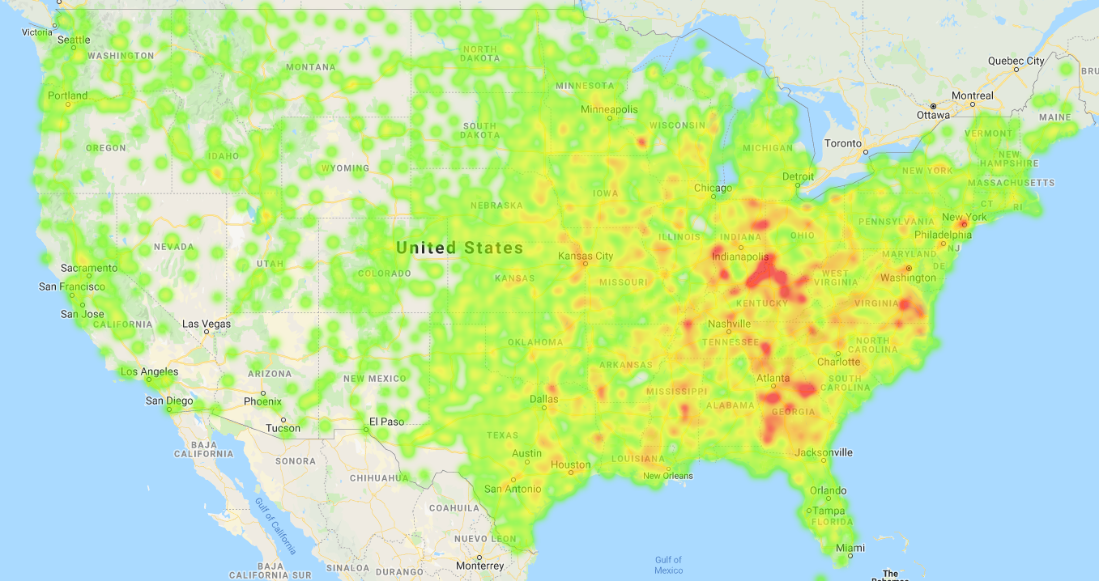

Slide 13
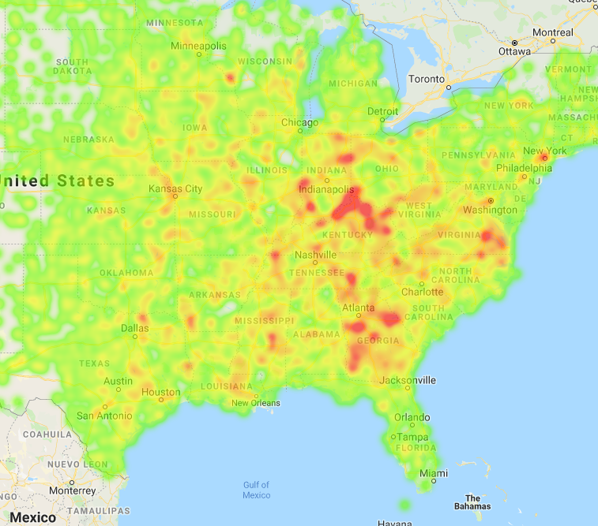
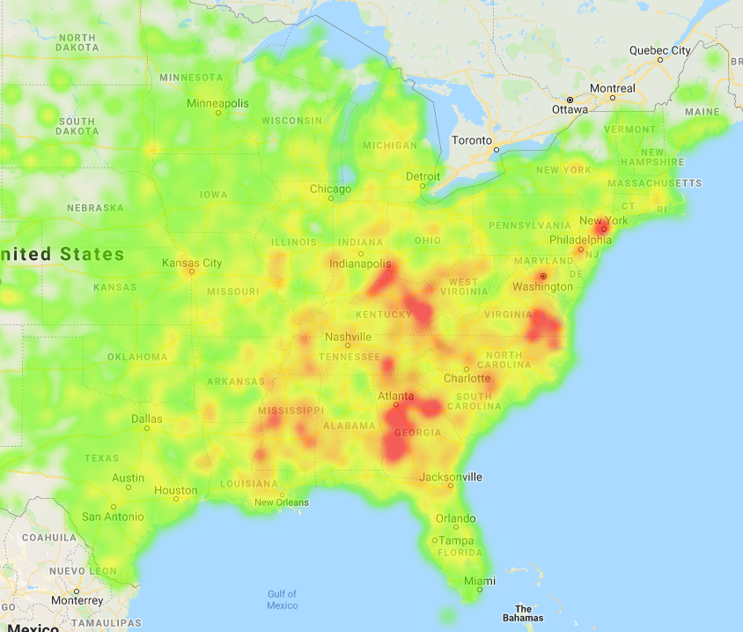
Blue Collar Job Heatmap
Unemployment Heatmap

Slide 14
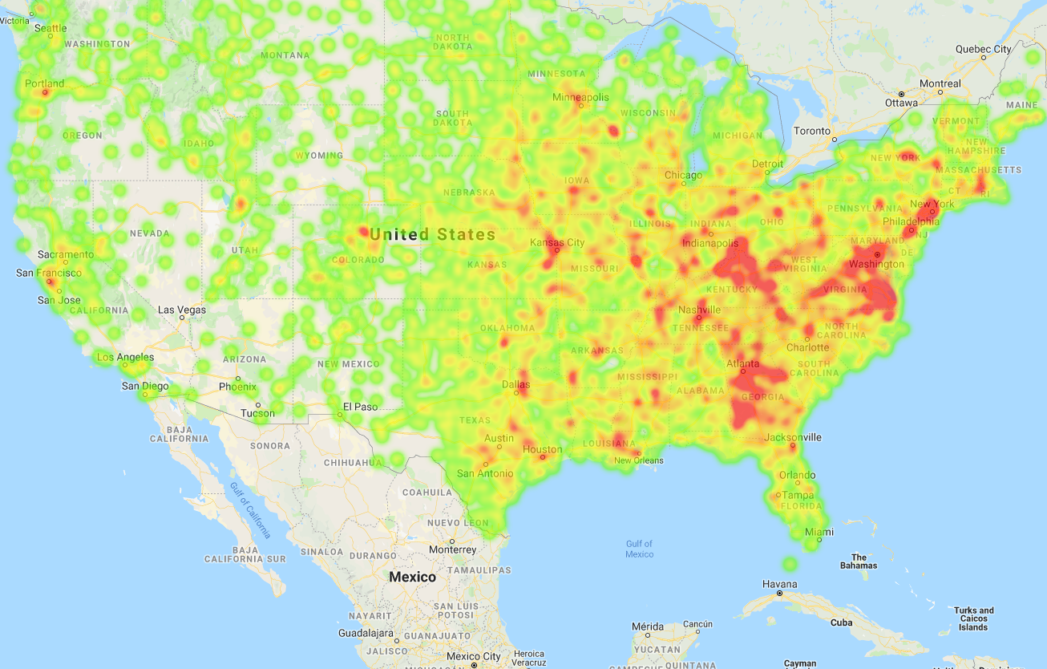
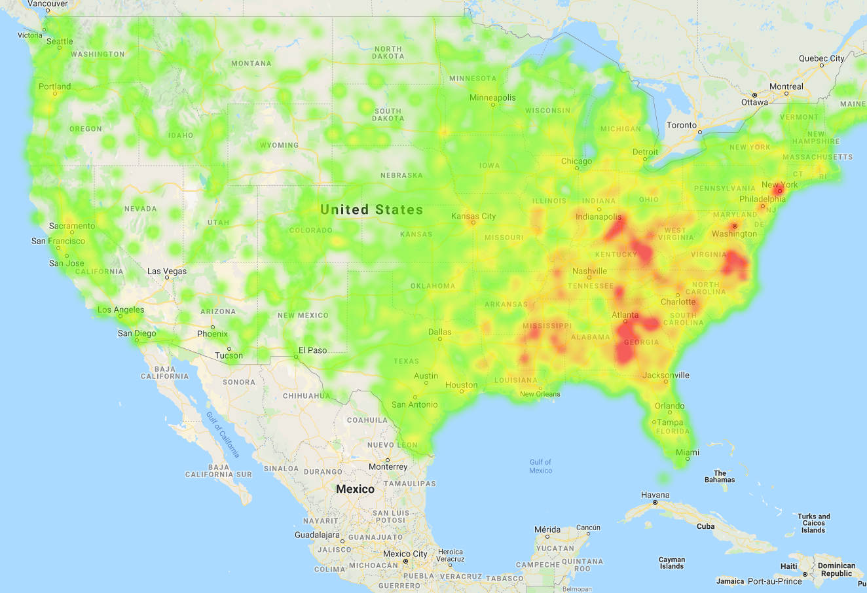
White Collar Job Heatmap
Unemployment Heatmap

Slide 15
Ethnicity and Unemployment
Examine data to see if there is any relationship between ethnicity and unemployment levels
This can be started by examining scatter plots of the data

Slide 16
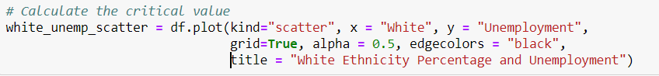
Visualization Buildup

Slide 17
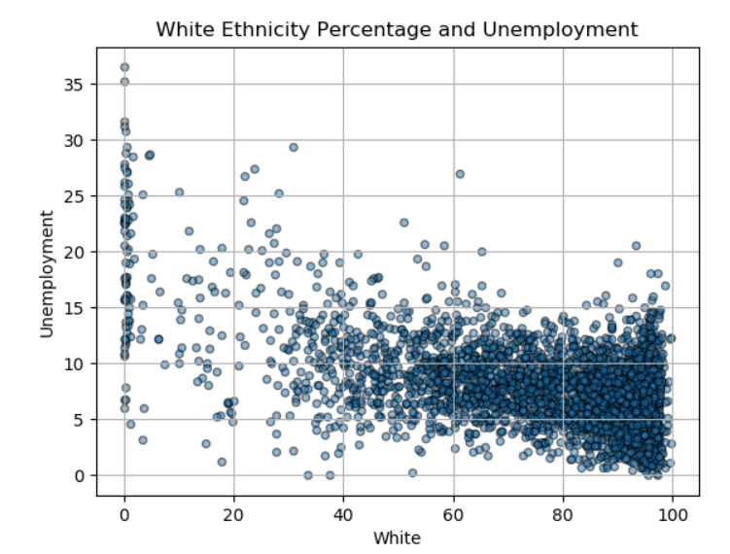
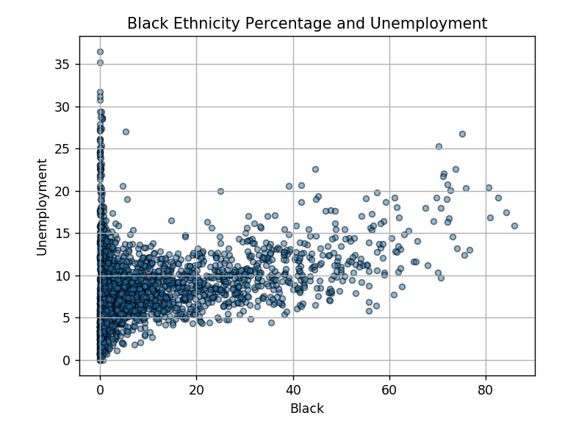
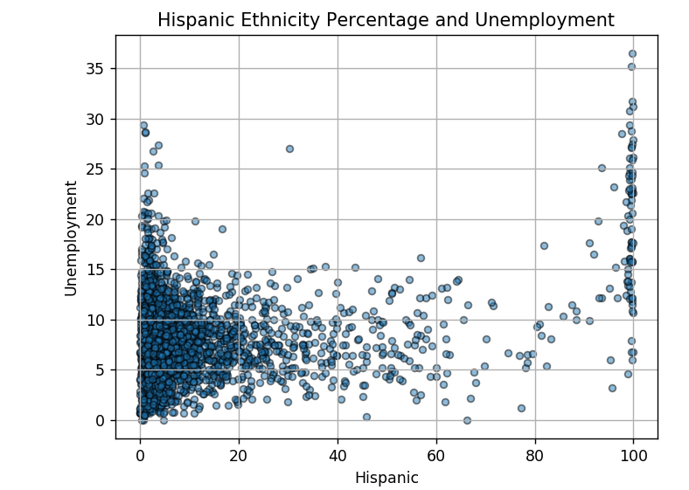
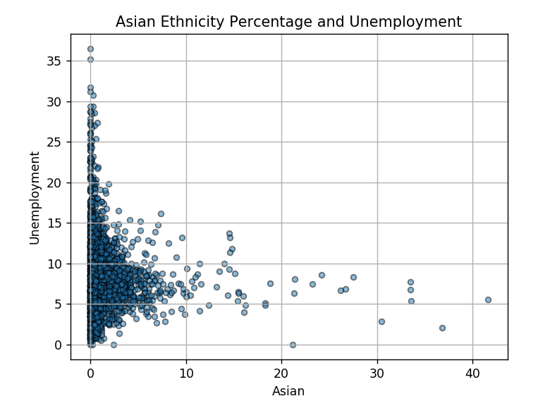
Not much useful information

Slide 18
Connecting Ethnicity Breakdown to Unemployment Mapping
Examine counties dominated by certain ethnicities
This will require the data to be filtered such that only counties with a set percentage of chosen minority will show
Impose this information on to unemployment heatmap layer
Reattach geographic coordinates without redoing API requests

Slide 19
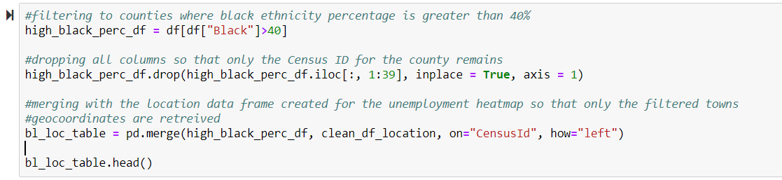
Data Cleanup Process

Slide 20
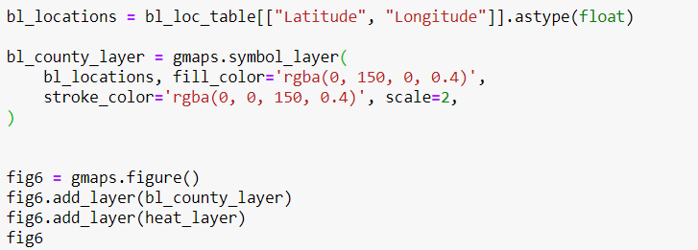
Visualization Buildup

Slide 21
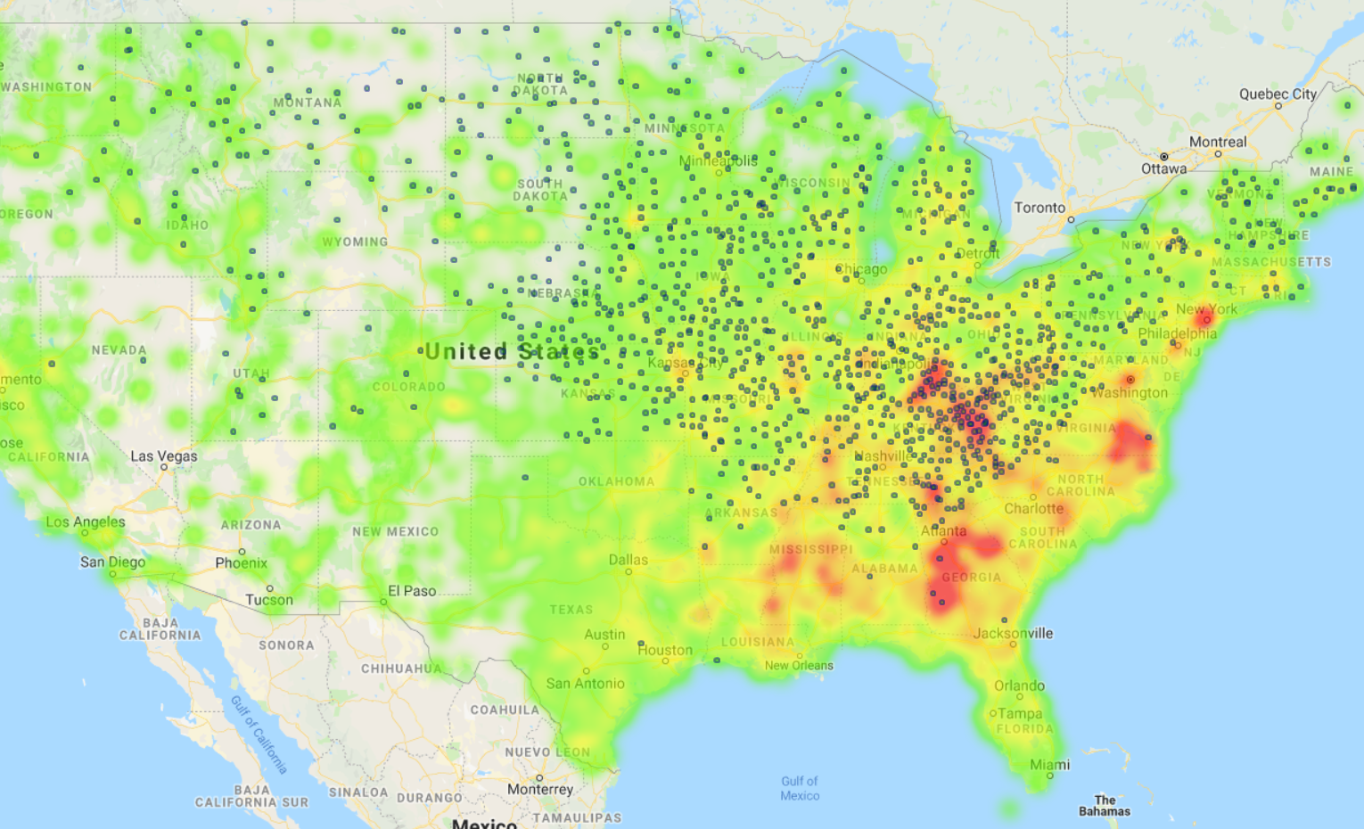
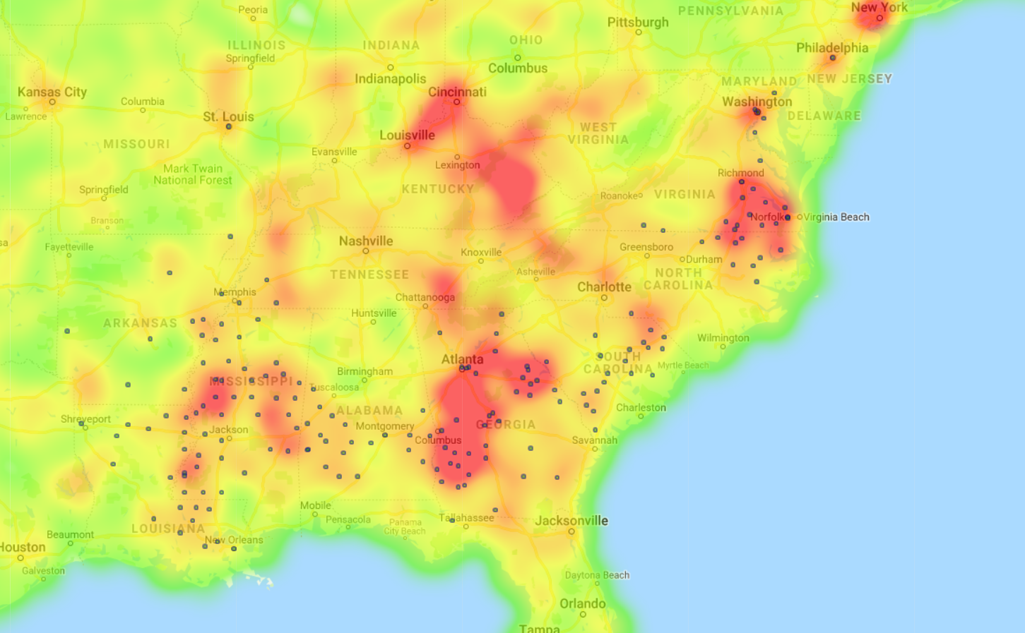
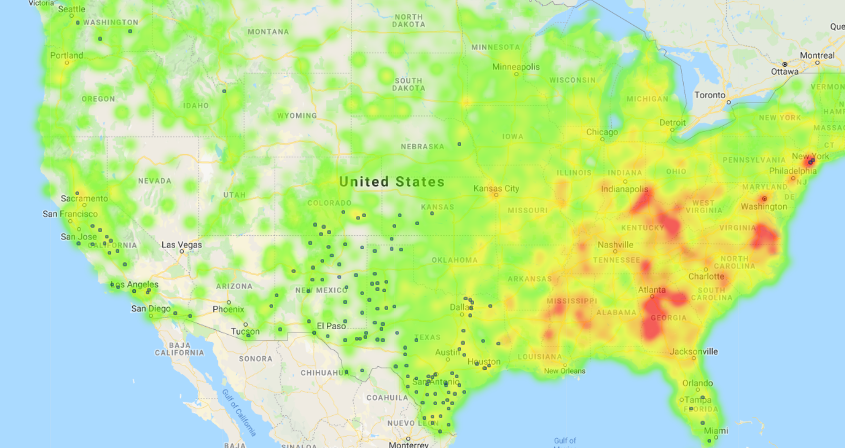
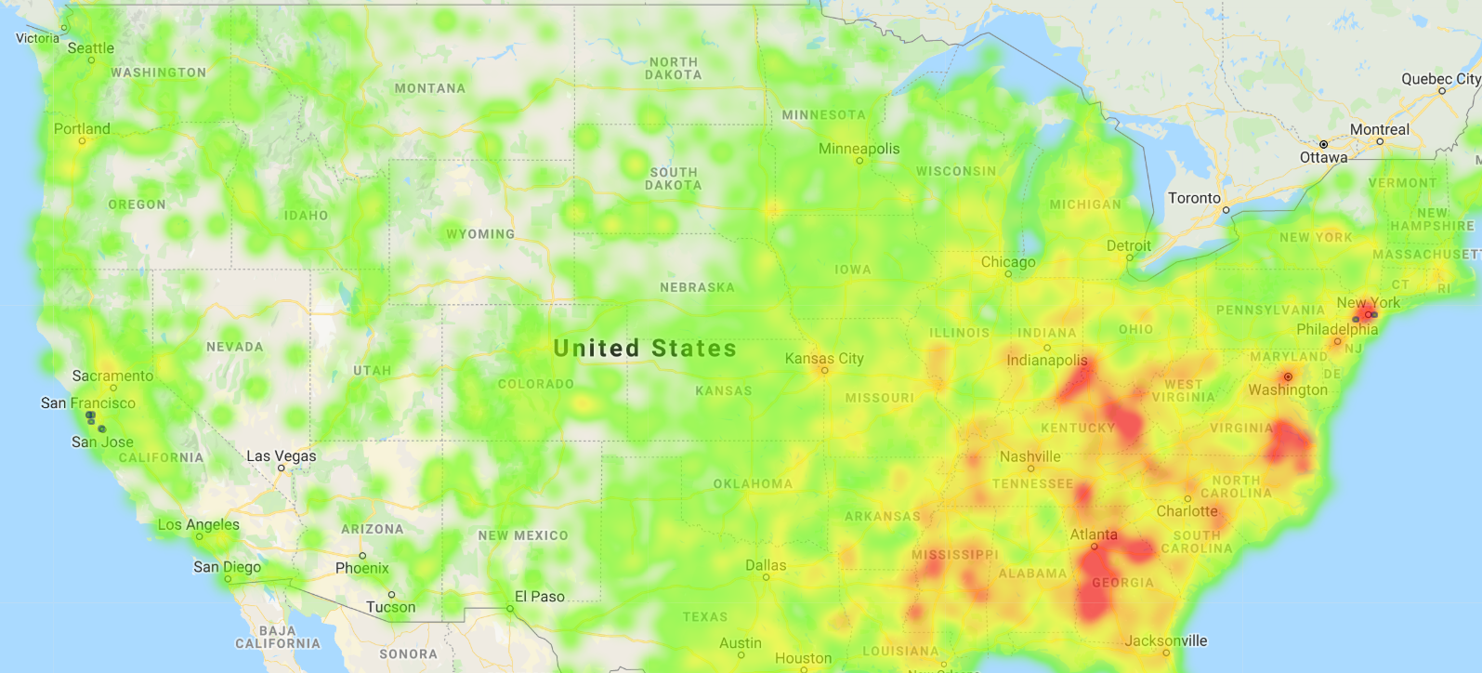
High White Percentage Counties
High Black Percentage Counties
High Hispanic Percentage Counties
High Asian Percentage Counties

Slide 22

Further Exploration
Ideally, we would have labor force numbers for each county and then combine that with the unemployment percentage numbers to have a more accurate heat map that displays unemployment in numbers rather than in rates
The above approach would also be applied to the job types
Would add additional years to potentially create an animation displaying the change in the unemployment heat map over the years

